Slide 1


Grid Watch:
Mapping Blackouts with Smart Phones
Noah Klugman*, Javier Rosa**, Pat Pannuto*, Matthew Podolsky**, William Huang*, Prabal Dutta*
University of Michigan*
University of California, Berkeley**
HotMobile 2014 – Febuary 26th, 2014
Notes:
Add uc logo

Slide 2
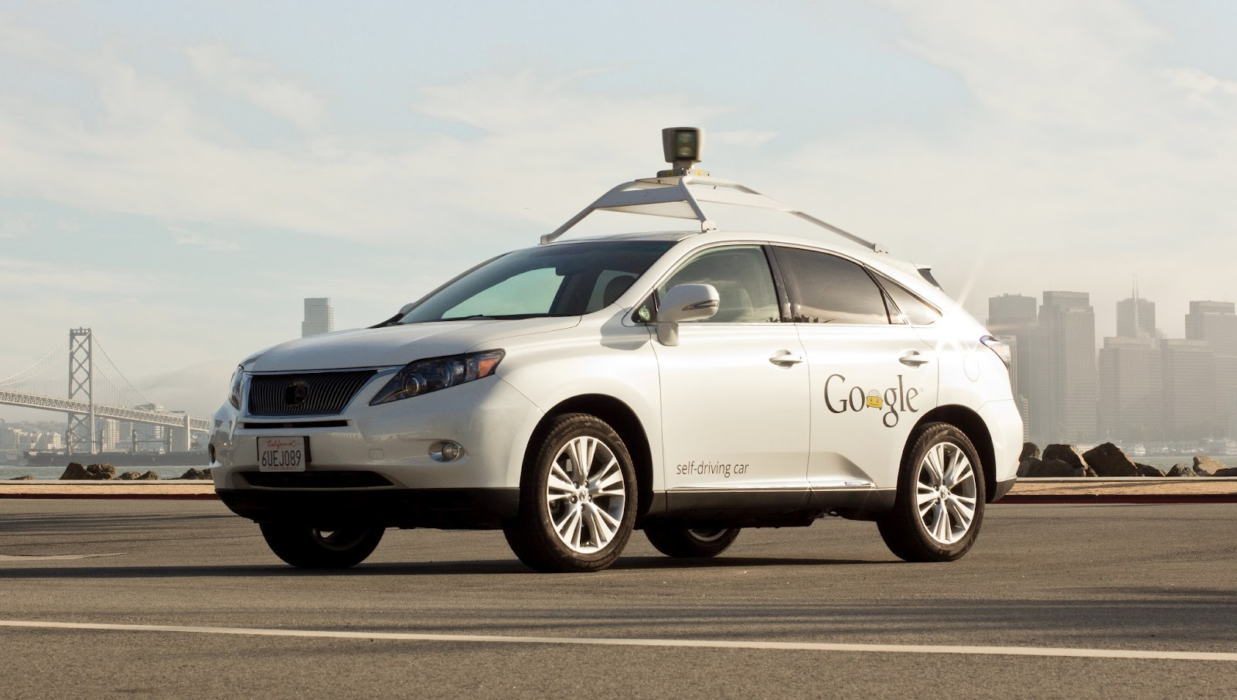
Making “dumb” smart.
photo: www.extremetech.com
Notes:
Andrew
Automate an important process
Expose new information
Inform the public

Slide 3
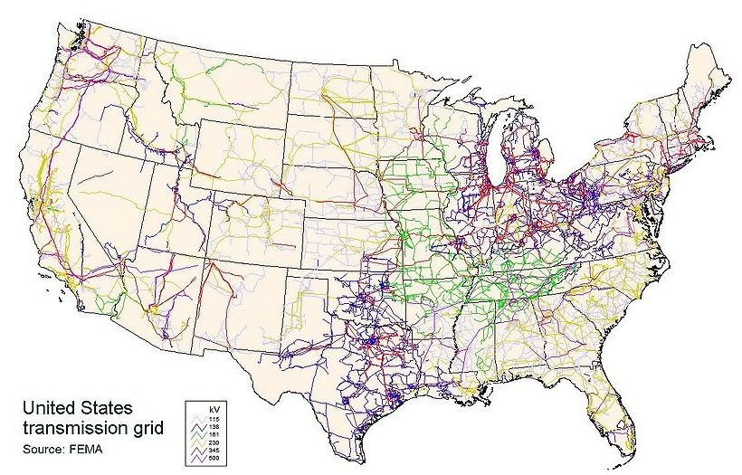
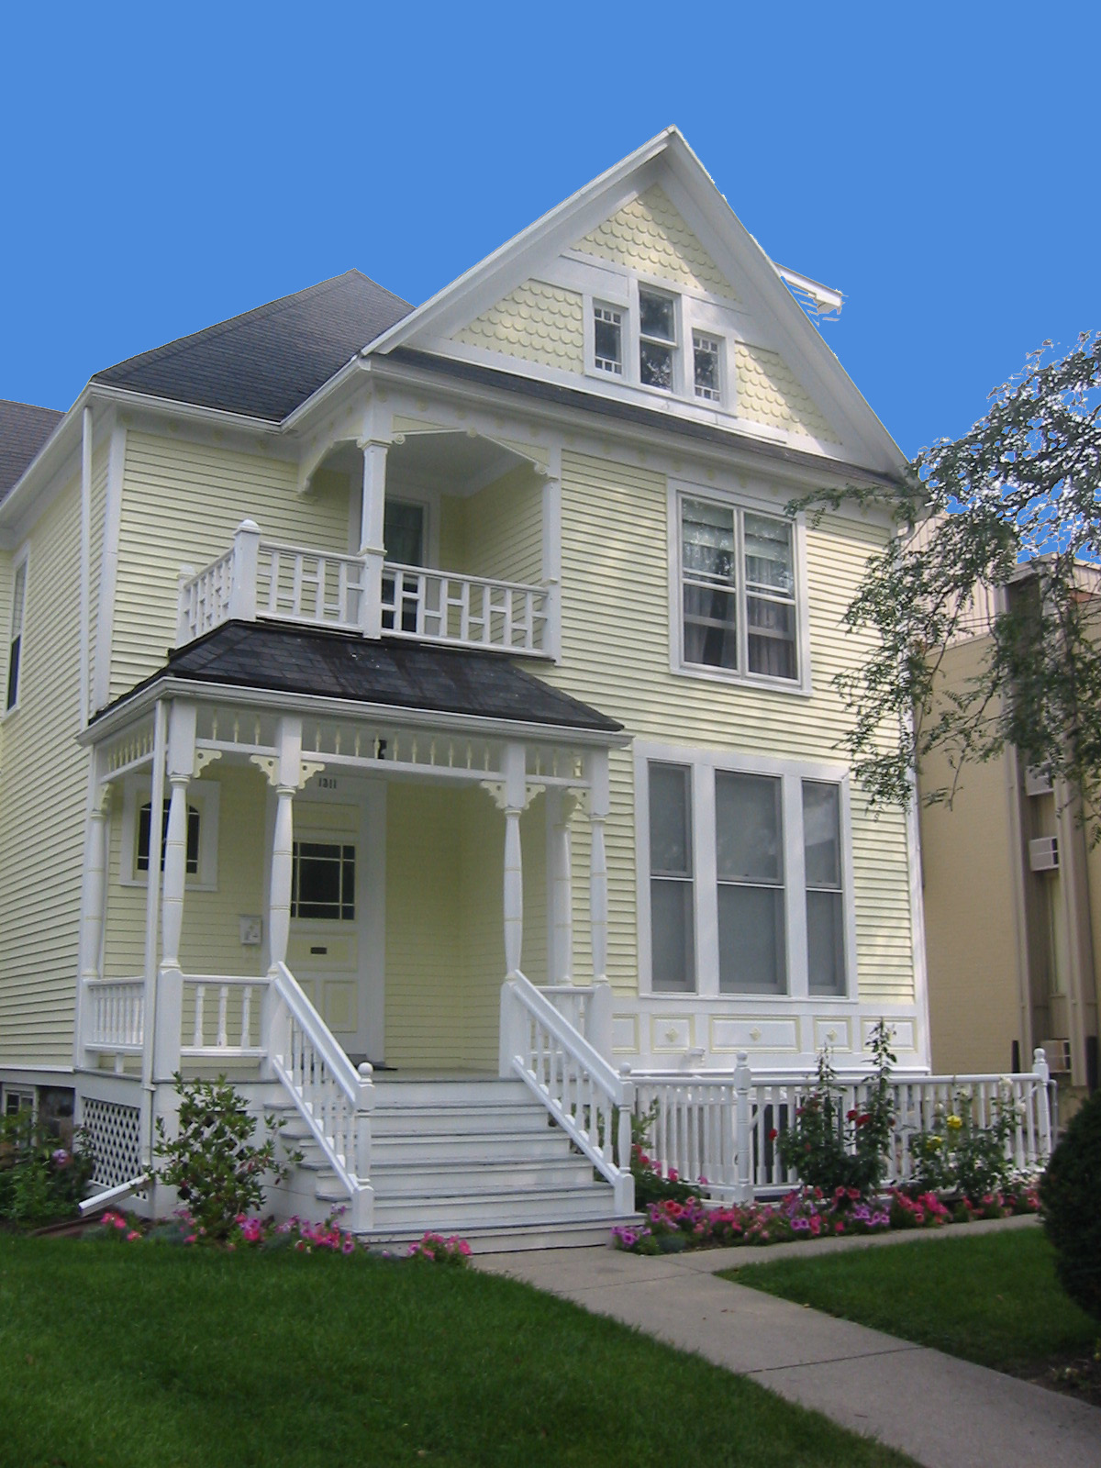
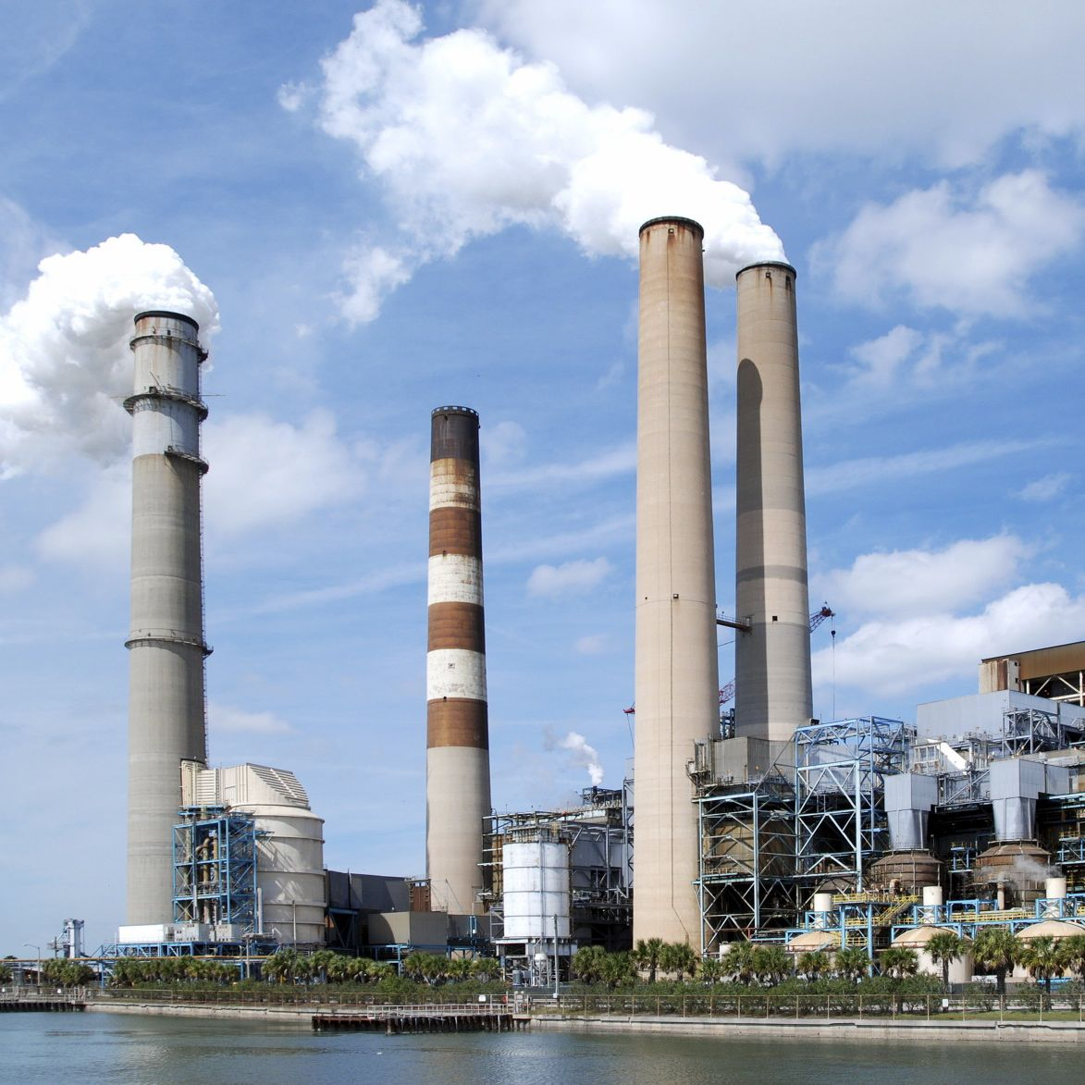
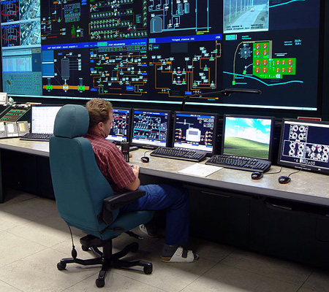
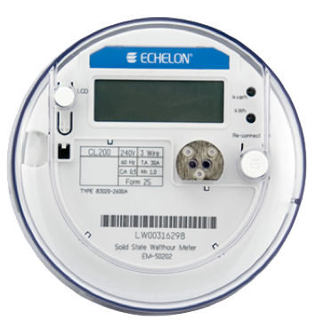
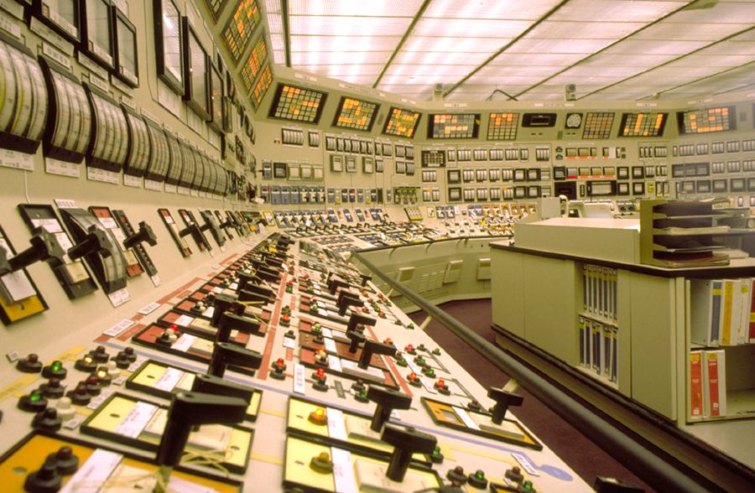
The health of the power grid is not well understood.
Generation
Transmission
Distribution
Source
Monitor
Notes:
Most complex thing we have ever built
No transparency
Power companies have this data at the substation level, but this isn’t much use to researchers
smart meter (get stats, internationally->steal it vs smart card)
Grid watch idea here, vague
(generation, transmission, distribution)
Set up infrastructure with monitor

Slide 4

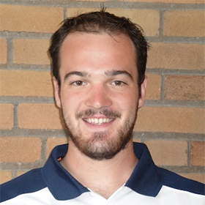
How It Works In Ann Arbor
T+0 Power Goes Out
.
.
.
T+12h Energy Company Call
Energy
Company
Energy
Company
Is your power out?
Yes. And I’m cold.
Energy
Company
Ok. Thank you.

Slide 5
How It Works In Ann Arbor
.
.
T+60h Energy Company Call
T+0 Power Goes Out
No. Still no power.
.
.
.
T+12h Energy Company Call
3 days and several phone calls later…
Is your power still out?
T+152h Call Energy Company
Yes. And I’m very cold.
Is your power out?
Ok. It will be back soon.
.
.
T+72h Call Energy Company
Yes. And I’m cold.
Calling to let you know my power is finally back.
Ok. Thank you.
That’s great. We’re sorry for the inconvenience.
.
.
.
T+36h Call Energy Company
My power is still out.
It’s been 3 days.
.
.
T+160h Energy Company Call
Are you sure?
We’ll send someone to investigate ASAP
My power is still out.
.
.
T+80h Energy Company Call
Hi! Just calling to see if your power is back on yet?
We’re aware and working on it.
Yes. It is.
Great! Thanks for letting us know!
Is your power back on?
Notes:
“While some of this can be attributed to the chaos of a large outage, there is very clearly still a problem”

Slide 6
How It Works In Ann Arbor
.
.
T+60h Energy Company Call
T+0 Power Goes Out
No. Still no power.
.
.
.
T+12h Energy Company Call
3 days and several phone calls later…
Is your power still out?
T+152h Call Energy Company
Yes. And I’m very cold.
Is your power out?
Ok. It will be back soon.
.
.
T+72h Call Energy Company
Yes. And I’m cold.
Calling to let you know my power is finally back.
Ok. Thank you.
That’s great. We’re sorry for the inconvenience.
.
.
.
T+36h Call Energy Company
My power is still out.
It’s been 3 days.
.
.
T+160h Energy Company Call
Are you sure?
We’ll send someone to investigate ASAP
My power is still out.
.
.
T+80h Energy Company Call
Hi! Just calling to see if your power is back on yet?
And this home has a smart meter installed…
We’re aware and working on it.
Yes. It is.
Great! Thanks for letting us know!
Is your power back on?
Notes:
“While some of this can be attributed to the chaos of a large outage, there is very clearly still a problem”

Slide 7
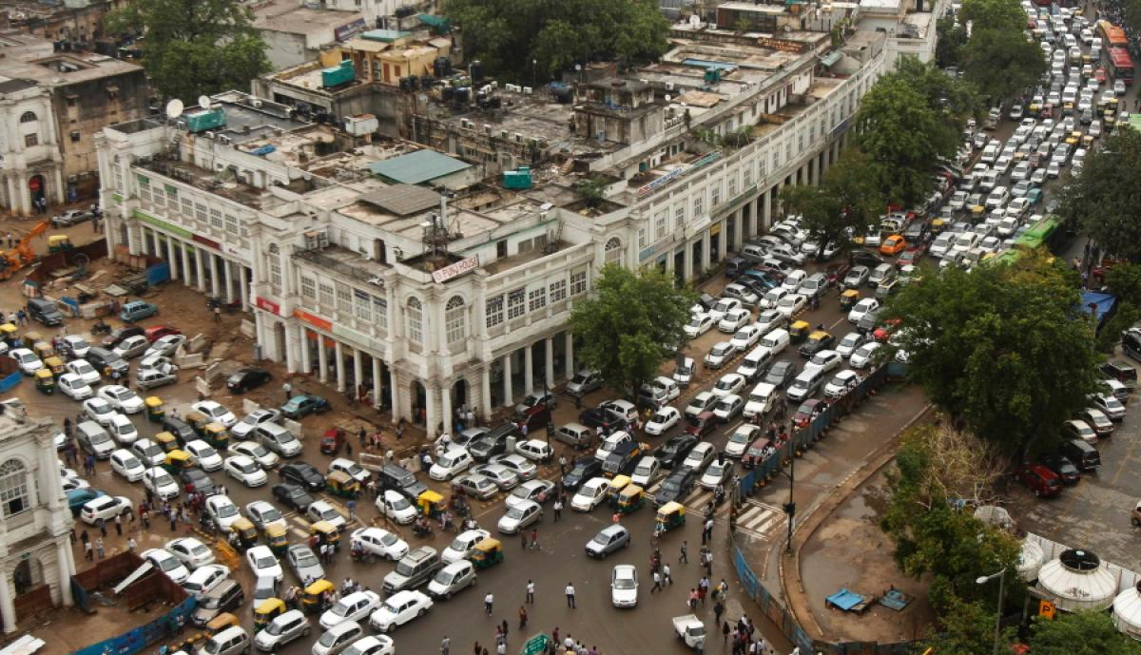
photo: Rajesh Kumar Singh/Associated Press
Notes:
Power grid failure in india… 600 million people
Show two extremes, distribution of power outages, extent and frequency and duration

Slide 8
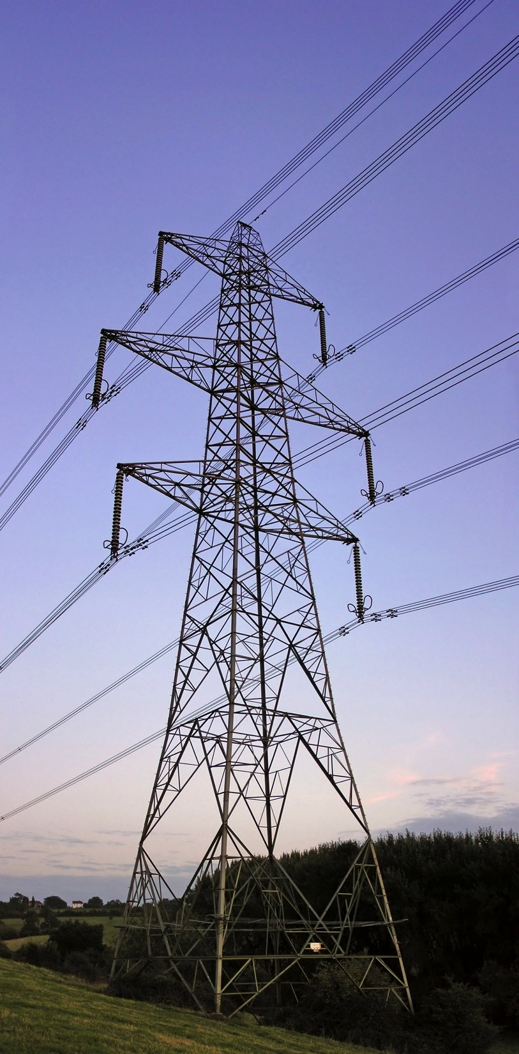
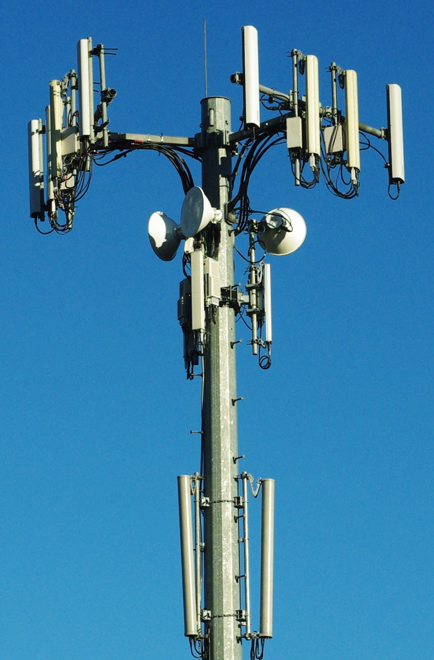
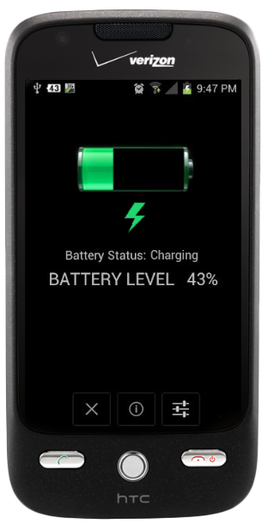
Detecting Power Outages With Smartphones
Notes:
Top level
When phones are unplugged
Everyone already installs for us
Show phone in the middle of the power grid and the cell network

Slide 9
We propose a global, crowd-sourced platform that leverages a simple side-channel available to smartphones—the charger status—to provide a simple, free, and easily deployable grid monitoring solution.
Notes:
Using this crowd sourcing technique, unmodified phones with present sensors we can …
Use a claim
Then why is this
The phone can observe 1 and report over 2

Slide 10
Crowd-Sourced Monitoring is Useful to Ratepayers, Researchers and Regulators
People want to know
How often does power go out in a neighborhood?
Is Eggman Electric more dependable than OmniCorp Power?
Where is the data to inform regulators that power is unreliable?
Notes:
Another channel
Calling power companies to ask for this and say no
No public available repo of outage data, especially not indepent of utility
Enable third parties – ratepayers, researchers and regulators, hold utilities responsible

Slide 11
Grid Watch

Slide 12



Architecture:
Grid Watch System
Filters
Report
Server
Displays
Grid Watch is woken up when charge state changes
Heuristics are used to filter out false positive events
When a true event is detected, data is gathered and sent to a central service
Data is displayed to the user and made available for download
Notes:
Dig into each piece

Slide 13
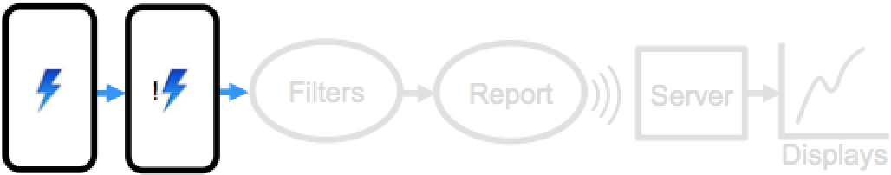
Architecture:
Charge State
Filters
Report
Server
!
!
Displays
OS subscribe to notification
Can wake up App on change
Timestamp at this point

Slide 14
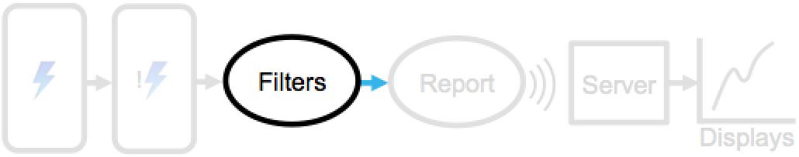
Architecture:
False Positive Filters
Accelerometer
Filters
Report
Server
!
Threshold
Displays
Microphone
Threshold
Additional Heuristics

Slide 15
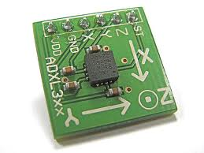
Architecture:
False Positive Filters: Accelerometer
Filters
Report
Server
!
Displays
People pick up the phone to unplug it
Low energy

Slide 16

Architecture:
False Positive Filters: Microphone
Filters
Report
Server
!
Displays
The microphone can detect AC mains
Higher energy

Slide 17
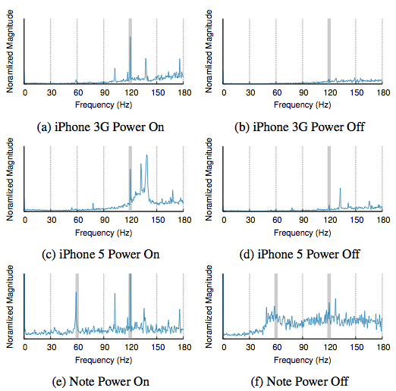
Architecture:
Filters: AC Mains Detection FFT
5 second recording
44.1 k, 16 bit
Sliding aggregate
1 sample window

Slide 18
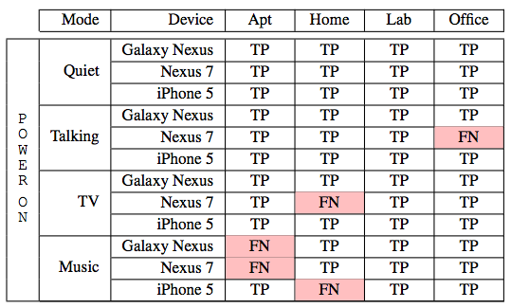
Architecture:
Filters: Noisy AC Mains Detection
Notes:
Relative amp is low

Slide 19
Architecture:
Filters: Additional Heuristics
Presence of WiFi
Audio context detection
External data (eg weather reports, power company sites)
Notes:
Relative amp is low

Slide 20
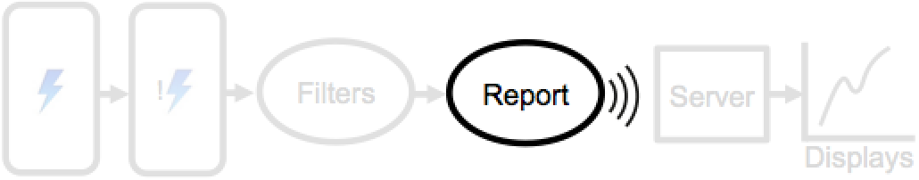
Architecture:
Uplink
Filters
Report
Server
!
Displays
GPS location, Unique ID, Timestamp
Local cache of outages
HTTP POST and SD log
Notes:
Only sample GPS after filters
Cache outage

Slide 21
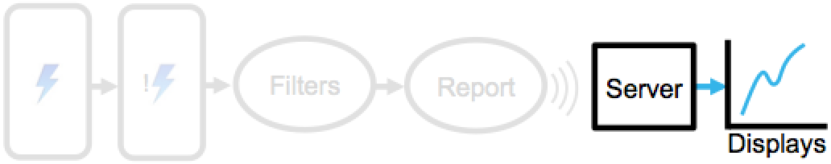
Architecture:
Central Service
Filters
Report
Server
!
Displays
Gathered into DB for further analysis
Indexed by phone, supports deletion and correction

Slide 22
Research Questions

Slide 23
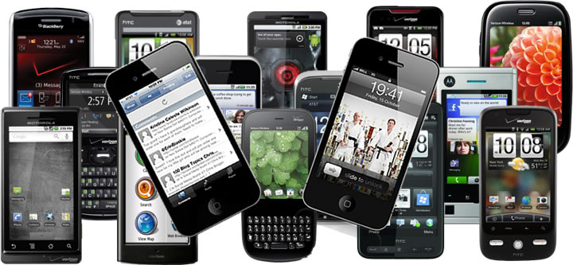
Research Questions:
Does Smartphone Diversity Impact Grid Watch?
Can all mobile platforms support Grid Watch?
How do we cope with sensor diversity?
What noise does this create in the aggregate?

Slide 24
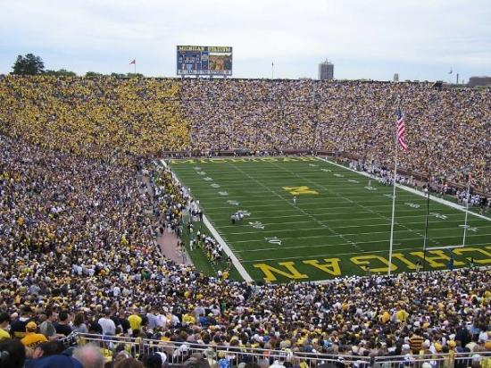
Research Questions:
How Much Grid Must Grid Watch Watch if Grid Watch Could Watch Grid?
How many phones must report in an area?
How will population dynamics change readings?
How can we incentivize use?
Notes:
Second session of the day, Phone Lab at the University of Buffallo

Slide 25

Research Questions:
Can We Identify Outliers?
How can we sanitize Grid Watch data?
  Faulty phones, bad actors, unfortunate homes
Notes:
Spatial temporal Clustering

Slide 26
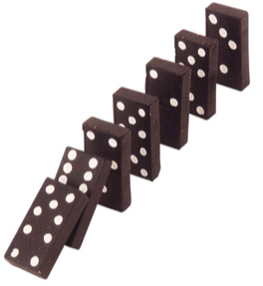
Research Questions:
Can Grid Watch Expose Complex Grid Events?
Can we track more complex grid behaviors?
How to process huge data, real time?
Higher resolution FFTs?
External sensors?
Notes:
Provide the strawman
Speculate on pre failure
Change to real questions
Huge data, real time

Slide 27
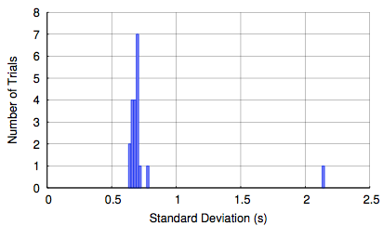
Research Questions:
Can Grid Watch Expose Complex Grid Events?
Notes:
Ten phones, six models, 20 trials
Avg std dev is .76 s between reports of an identical outages
19 out of 20 trials, standard deviation less than .8 seconds
Cascading outages spread in minutes
3g, a mix of networks
Histogram not the way to show this

Slide 28
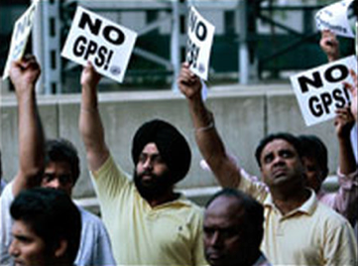
Research Questions:
Privacy
Photo: NPR
How can we best preserve privacy?
What granularity location data is needed for meaningful analysis?

Slide 29
Deployment

Slide 30
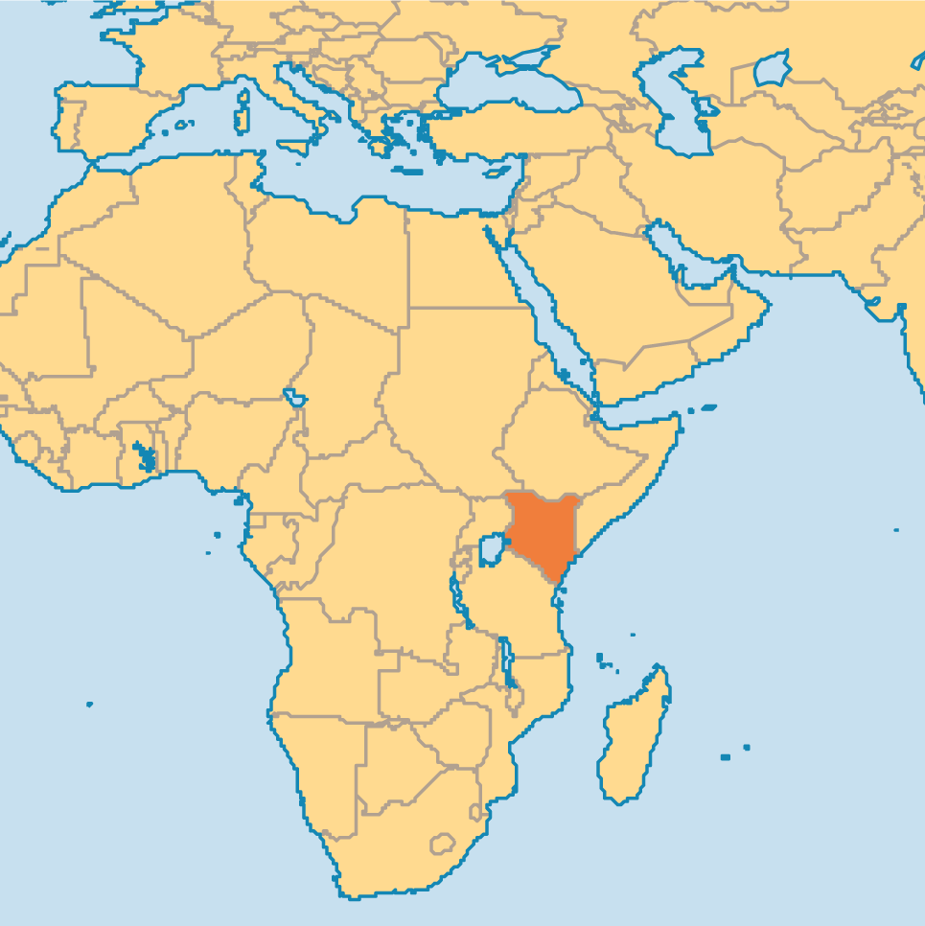
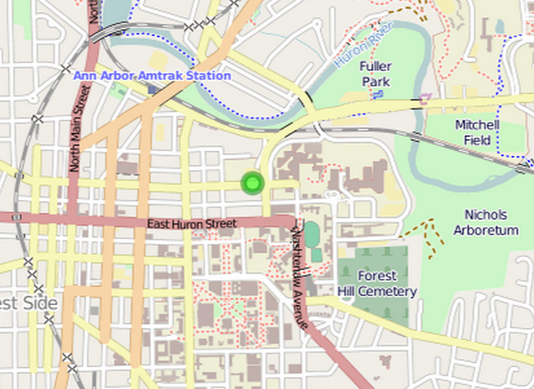
Initial Deployments
Ann Arbor
Kenya
Lab phones, eventually Play Store
http://inductor.eecs.umich.edu/gridwatch.html
15 phones
Mid-March

Slide 31
Grid Watch
Propose a simple, scalable, grid monitoring solution deployable independently of utility companies
Require no additional infrastructure
Demonstrate the feasibility of false positive filters
Identify key research questions for future work
Noah Klugman
University of Michigan
nklugman@umich.edu

