Slide 1


Experience: Android Resists Liberation from Its Primary Use Case
Noah Klugman†, Veronica Jacome†, Meghan Clark†, Matthew Podolsky†,
Pat Pannuto†, Neal Jackson†, Aley Soud Nassor‡, Catherine Wolfram†, Duncan Callaway†, Jay Taneja*, and Prabal Dutta†
ACM MobiCom, Nov 1st, 2018
New Delhi, India
†
*
‡

Slide 2
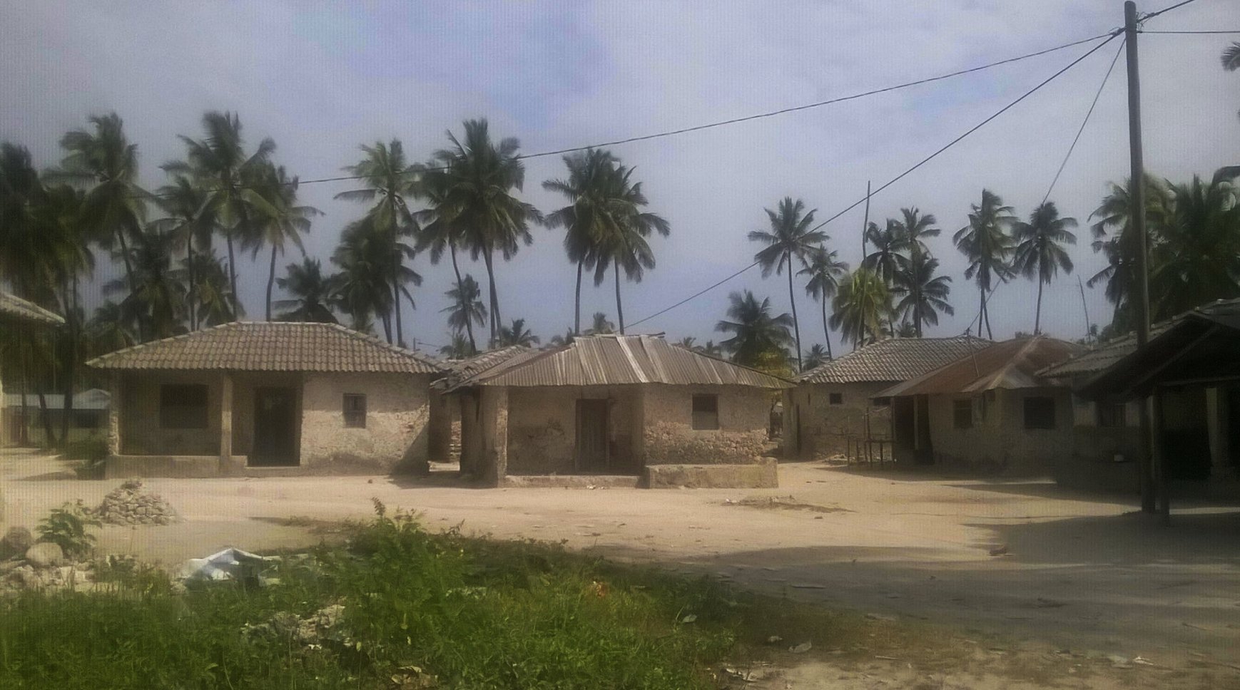
Application: Sensing AC grid reliability in Zanzibar
Michamvi, one of our two deployment sites in Zanzibar
Photo by Veronica Jacome
Notes:
We were approached by a group of researchers who were interested in exploring how low-voltage AC grid energy reliability changes as a function of a households distance from a distribution transformer. The population under study was in two villages, Michamvi and Jambiani, in Zanzibar, Tanzania. Each village had a population of around 1000 people living most typically in single family households. Pictured here is Michamvi and this picture is a fairly good representation of what the households looked like.

Slide 3
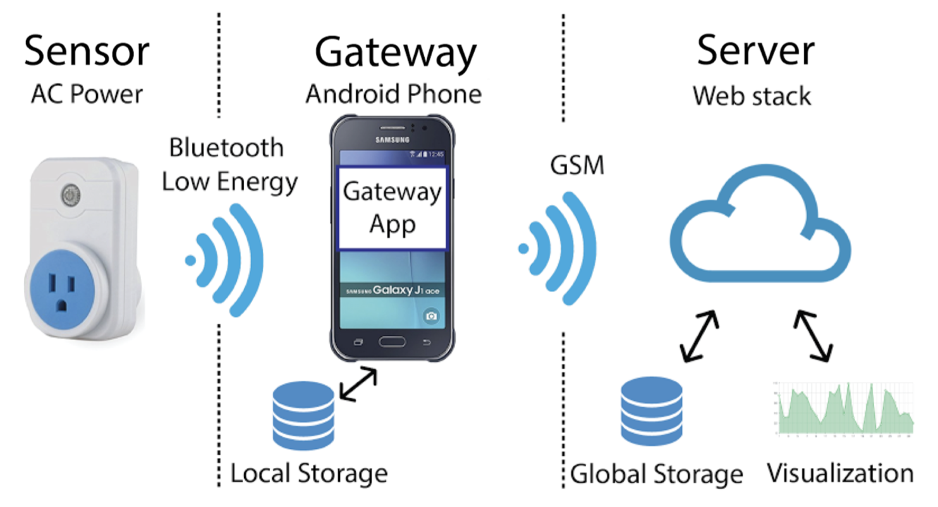
Challenge: get data from sensor to cloud
?
?
Sensor: WiTenergy E110
  Voltage, current
  Bluetooth Low Energy
Backend
  node.js + influx
Gateway: ?
?
Notes:
The deployment timeline was pretty quick, so we immediately started thinking about how to quickly spin up a sensor system that would be accurate, reliable, and within the budget constraints. This brought us to explore what was commercially available. [*] We found a commercial off the shelf AC power meter that took the required measurements and would transmit them over Bluetooth low energy, and this seemed great. [*] Filling in the system on the other side we were able to reuse a simple cloud service from another deployment to receive HTTP POST requests and save them to a database. [*] Really then, the biggest remaining question was how to get the power measurements from Bluetooth back the cloud. We couldn’t find any commercial product that shuttles Bluetooth to the cloud, which meant we would have to build something.

Slide 4
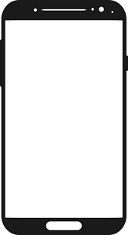
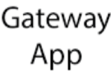
Insight: Android smartphones should make the gateway as easy as writing an app
Sensor: WiTenergy E110
  Voltage, current
  Bluetooth Low Energy
Backend
  node.js + influx
Gateway
  Android smartphone!
  Mature ecosystem
  Background services
  BLE radio, GSM radio, SD card
  OTA updates
Notes:
Fortunately, there is easily accessible, highly programmable commercial hardware that bridges Bluetooth and the cloud: the smartphone. So we decided to build a gateway based around Android. Android provides a OS primitive – background services – that should allow for long running processes, like a gateway app. The Android ecosystem promises easy over the air app updates, allowing remote patching of a quickly deployed system. We called our full system PlugWatch. At the end of the day in 2016, all we’re doing is writing a phone app so this should easy…

Slide 5
Insight: Android smartphones should make the gateway as easy as writing an app …right?
Sensor: WiTenergy E110
  Voltage, current
  Bluetooth Low Energy
Backend
  node.js + influx
Gateway
  Android smartphone!
  Mature ecosystem
  Background services
  BLE radio, GSM radio, SD card
  OTA updates
Notes:
…right?

Slide 6
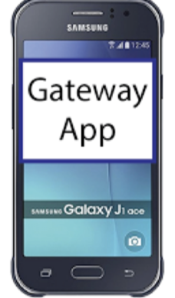
Let’s start putting together a deployment…
Pick a phone: Samsung J110H
  Mid-range hardware
  Low-cost ($90)
  Widely available in Tanzania
  Upgraded to Android 4.4.4
    (and eventually rooted….)
Notes:
To start, we need a phone. We chose the Samsung J110H, which at the time of the deployment in late 2016, was a mid-range headset available the local market. The phone wasn’t a powerhouse, but we had a fairly simple use case in our gateway. The J110H had spent about a year on the market and came stock with a 1.3 GHz processor, 512 gigs of RAM, and Android KitKat 4.4.2, which we updated to 4.4.4, the maximum API available for the headset at the time of deployment.

Slide 7
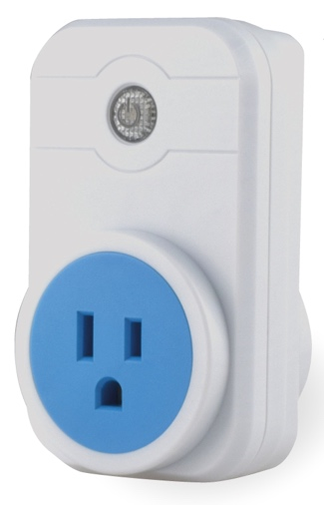
Write an app…
Every 1 second, POST latest data
Backend
Cellular
Listen for Bluetooth packets with power data
Bluetooth
Save copy of data to local storage
Notes:
And we implemented an app that conceptually is very simple: It listens for Bluetooth packets, saves a copy locally, and sends them to the cloud once a second.

Slide 8
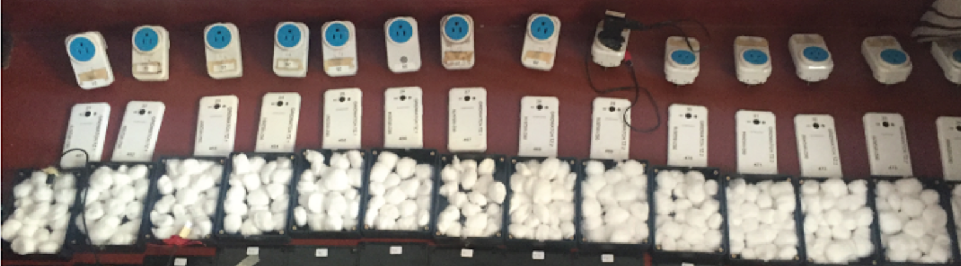
And send it out into the field!
Deployment of 16 systems in two villages in Zanzibar
Plugged in at an outlet inside a household
Phone was placed in a plastic box and screwed shut
PlugWatch designed to run continually
Notes:
With our system designed, we prepped for deployment. The deployment covered 16 homes in two different villages in Zanzibar. To find participants, we hired three local staff members, called field officers. These field officers would visit potential participants, explain the experiment and seek consent for enrollment. To minimize tampering, we placed each phone in a black plastic box screwed shut with security screws. After deploying PlugWatch in Tanzania, we flew back to the United States, and started to wait for data to come in from the field.

Slide 9
PlugWatch was supposed to be easy…
Simple system based on commercially available components
We assumed Android would trivially act as a gateway
Notes:
So unfortunately this where our experience paper pivots into a bit of a darker place. Largely, PlugWatch failed, and it failed for reasons that were quite surprising to our research team.

Slide 10
Phones on their own?
Most smartphone use cases are interactive, a human holding a phone
Tight Association^{[1]} :
  Assumption of frequent interactions between the human and the phone
Loose Association:
  Apps are continuously-running, unsupervised, and characterized by machine-to-machine interactions
[1] Ivan Beschastnikh, Yuan Zhang, Zhengping Qian, and Lidong Zhou. 2012. Liberating Mobile Phones from their Primary Use Case.
Notes:
As a preview of the coming challenges, our application is actually a bit of an odd request for a modern smartphone. In practice, when you think of actual day-to-day uses of smartphones, there is almost always a human involved. Formally, this is referred to as Tight Association, [*] where the phone is designed for the best possible user experience. In contrast, PlugWatn demands a so-called Loose Association application, [*] where a phone is on its own without a user. A loose association application is primarily interested in machine to machine communication. I’ll be referring pretty regularly to these two different terms, and really they are design philosophies. We find that a device designed for multi-tenant operation and frequent human interaction becomes unreliable when tasked to continuously run a single application with no human interaction. But at this point in the story, everything is still supposed to be easy…

Slide 11
Latent Hypothesis
Smartphones enable unattended long-running networked sensing applications through their rich supporting environments, wireless peripheral connectivity, and physical reliability.
Notes:
Thinking back on this all, we realized we had a latent hypothesis while designing PlugWatch, which is that smartphones enable unattended long-running networked sensing applications, like a gateway, through rich supporting environments, wireless peripheral connectivity, and physical reliability. In our deployment, each one of these clauses broke down as we attempted to force a tight association smartphone that was expecting human interaction to instead act as a loose association gateway. Now our single deployment had a fairly small population and was based on a single Android headset. While our deployment was not designed to be an experiment formally proving this hypothesis to be true, in practice our experience demonstrates that each part can fail in real world scenarios.

Slide 12
Latent Hypothesis / Outline
Smartphones enable unattended long-running networked sensing applications through their rich supporting environments, wireless peripheral connectivity, and physical reliability.
Notes:
We are going to use this latent hypothesis as the outline for the rest of the talk, and go through each part of it briefly starting with

Slide 13
Latent Hypothesis / Outline
Smartphones enable unattended long-running networked sensing applications through their rich supporting environments, wireless peripheral connectivity, and physical reliability.
Notes:
The idea that smartphones support Unattended long-running process.

Slide 14
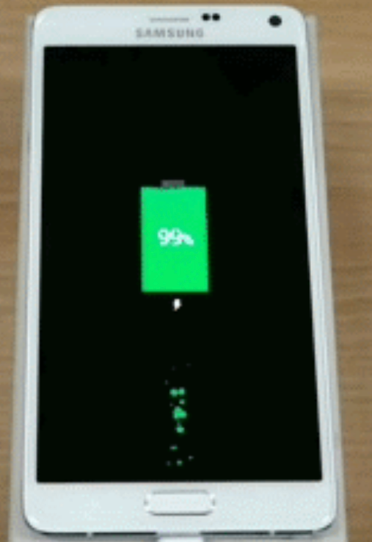
It is difficult to keep apps running without a human in the loop.
OS garbage collection makes it hard to run an app for long periods
Tricks to keep a loose association app alive:
  Force the UI open on the screen
  Generate notifications
  Catch crashes and reboots to restart app
  Close modal windows
  Multiple watchdog processes
  Overwrite the charging image to auto start the phone on charge restored
https://news.samsung.com/global/this-is-an-unofficial-review-of-the-galaxy-note-4-apps-ultra-power-saving-mode-fast-charging-and-more
Notes:
Ok. Jumping in. The first thing we noticed was that Android would kill our long-running process to handle memory pressure and as part of the OS general garbage collection routine. This is design decision that makes a lot of sense in a tight association context. App’s shouldn’t be able to take arbitrarily large amounts of system resources, it would detract greatly from the user experience. In our loose association context though, this was our first real engineering challenge. We found a number of tricks to try to keep an app alive. Android won't garbage collect an app a user running, so we force the screen to remain on as if the user is viewing. Unfortunately, this wasn’t enough to keep our app alive. So we faked user interactions by popping up system notifications from the app periodically. But this didn't do the trick either. No app is perfect and when crashes will happen, but without a human to push a button to restart, we require a top-level crash handler to restart the app automatically. Yet this still is not enough to keep an app running. Occasionally, the OS will pop up modal system information dialogs, which removes the app from the foreground. These are normally easily dismissed by a person who wishes to keep using the phone, but in loose association we had to use accessibility services to click the bottom-right-most button, hoping that was "OK". Even with all these tricks, in testing, our gateway process would still eventually be killed by the OS. So we set up multiple watchdog processes to restart each other and the main app, and hoped that at no point would the OS kill all of these processes at the same time. Of course, as you may be guessing, all this was STILL not enough. Acting as power meters on a highly unreliable grid, phones would often discharge completely. Dead phones do not automatically boot when power comes back, a problem when there is no one around to press the power button. Fixing this required rooting the phone. We modified the phone so that when it tried to launch the power restore display, the system would instead trigger a call to system/reboot which then started the phone and our app. Turns out we were lucky to have selected a Samsung phone early on, as this particular boot-on-power hack only worked for Samsung phones. Stepping back, no one of these things was very hard, but all of them together represented real and unexpected engineering time again to try to force Android to support a loose association application.

Slide 15
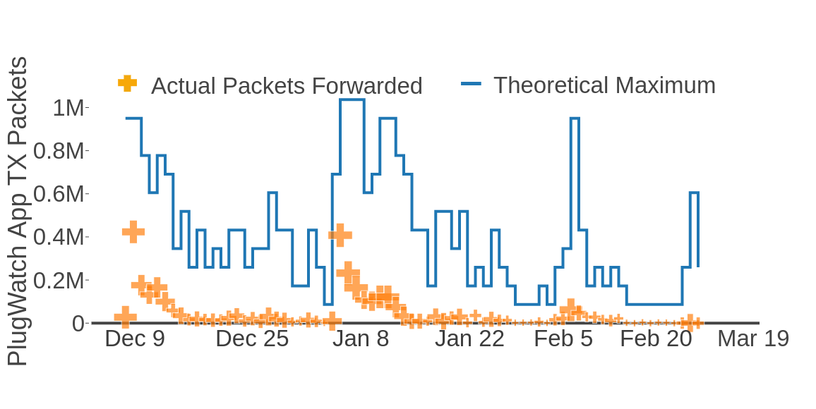
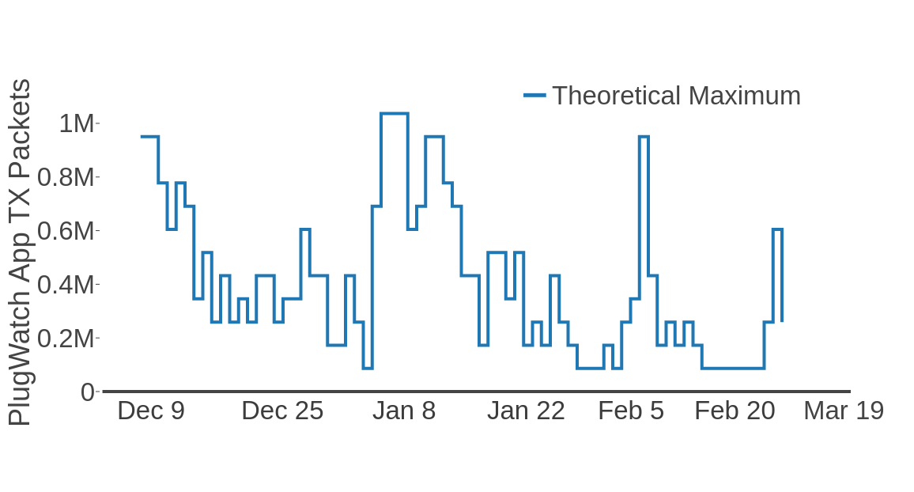
And still… the system drastically underperformed
1 Hz data x number of seconds in day x number of phones reporting at all that day
Notes:
So this is a sad slide to show. On the X-axis we see time and on the y-axis we see the number of packets received by our cloud service. The blue line shows the theoretical maximum packets were were expecting for the day. This is calculated by the number of phones that sent a single packet that day multiplied by the number of seconds in a day because the data is sent at 1 hz 24 hrs a day. The fact that the theoretical maximum is so varied shows that for nearly every day, many phones did not forward a single packet. Not ideal. Even worse, the yellow crosses show the sum of the actual packets forwarded across all 16 phones, which even at the most performant days are less than 50% of the theoretical maximum. This shows that even when the gateway process was on, it didn’t work reliability. This performance was shocking to us, and really did not represent what we were seeing in laboratory testing, which was much closer to the theoretical maximum. We wouldn’t have shipped our deployment otherwise. It is worth pointing out one more thing about this graph, which is at the peak performant days

Slide 16
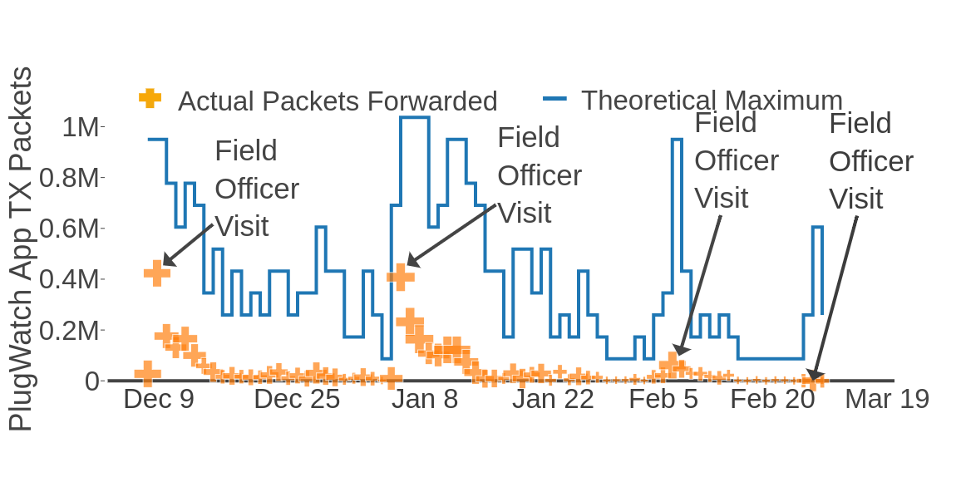
Over long timespans phone build up residue that humans need to clear out.
1 Hz data x number of seconds in day x number of phones reporting at all that day
Notes:
These were the days that our field officers, the local staff supporting our deployment, visited the phones at the deployment households. After the first month, which performed poorly, we ended up changing our experimental protocol so that each month a field officer would visit each phone, unscrew the box, take out the phone, and do everything that was needed to get the app running again. After a human interacted with the phone, breaking loose association, performance was higher for a couple days, and then fell off at a rough exponential decay.

Slide 17
Hypothesis / Outline
Smartphones enable unattended long-running networked sensing applications through their rich supporting environments, wireless peripheral connectivity, and physical reliability.
Notes:
Ok. So unattended long-running was hard and wasn’t ultimately achieved. This was a big one to loose.

Slide 18
Hypothesis / Outline
Smartphones enable unattended long-running networked sensing applications through their rich supporting environments, wireless peripheral connectivity, and physical reliability.
Notes:
Lets cross it off and move on.

Slide 19
Hypothesis / Outline
Smartphones enable unattended long-running networked sensing applications through their rich supporting environments, wireless peripheral connectivity, and physical reliability.
Notes:
To networked sensing applications.

Slide 20
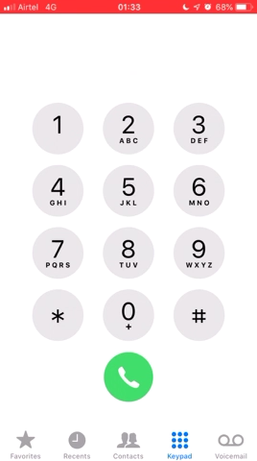
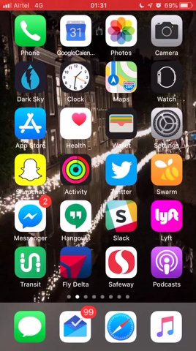
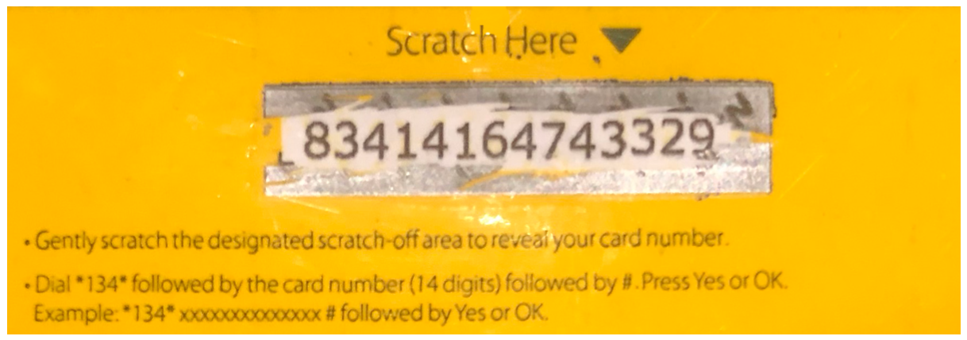
Keeping multiple phones connected remotely was difficult
SIM card data plans were non-trivial.
Hard to diagnose connectivity problems.
  Adding data done via scratch-off cards
  Data had to be topped up every 30 days in-country
  Hard to diagnose connectivity issues
Fleet management is not well supported.
Loading value
Check Balance?
Notes:
So challenges keeping a device connected to the GSM network are not exclusive to cell phones, but were significant and did challenge our latent hypothesis. In Zanzibar, the only SIM cards we were able to purchase without an agreement with the telecom were prepaid sim-cards, which felt fine at first glance. The pre-paid cards received a data allowance from vouchers, which were applied to a SIM by scratching off a voucher and typing a unique ID into a USSD application. [*] USSD are miniature text based applets accessed by dialing * and then a short code, and they will only work if you are in country. Unfortunately, the pre-paid data plans expire monthly, requiring a human physically in Tanzinia to dial recharge numbers every month for every phone in the deployment. It was impossible for our research team out of country to check balances when debugging connectivity or adding data to SIMs, requiring additional training and trust of the local field officers. Top-ups could be avoided with post-paid cards, akin to most US phone plans, however, these plans require establishing a valid line of credit in-country with the mobile phone operator. Regardless of pre-paid vs post-paid, getting multiple SIMs at all is challenging. We were limited to purchasing 3 SIM cards per ID for security reasons. We have found this same limitation in similar GSM sensor work that we have been doing in Kenya, Ghana, Nigeria, Venezuela, and very recently for our demo at MobiCom here in India. In practice this can be worked around, for example finding an employee willing to bend the rules and sell us 16 SIMs, but such ad-hoc methods do not really scale. Again, all of this makes sense for a tight association context, where a user is supposed to have a small number of phones. For loose association, it presents a problem.

Slide 21
Hypothesis / Outline
Smartphones enable unattended long-running networked sensing applications through their rich supporting environments, wireless peripheral connectivity, and physical reliability.
Notes:
Ok. So keeping a bunch of phones networked ended up being hard. Lets continue on…

Slide 22
Hypothesis / Outline
Smartphones enable unattended long-running networked sensing applications through their rich supporting environments, wireless peripheral connectivity, and physical reliability.
Notes:
And look at the rest of what

Slide 23
Hypothesis / Outline
Smartphones enable unattended long-running networked sensing applications through their rich supporting environments, wireless peripheral connectivity, and physical reliability.
Notes:
Smartphones offer our system, like rich supporting environments.

Slide 24
Android ecosystem necessitates careful thinking
Not all Android is created equal
  Ecosystem does not equally support all APIs
Automatic App Updates?
  Android Profiles (req 5.0+)
  Non-deterministic Google account logouts make orphans
Bug fixes don’t reach down into old API’s
  And OS updates always require human intervention
Notes:
we found that not All Android is Created Equal. The Android ecosystem does not equally support both different Android API’s and different hardware to a depth we didn’t anticipate. [*] For example, one of our primary motivations for using Android was that for our team back in the US, we could easily ship reliable over-the-air updates to our app. Unfortunately, the automated tool to set this up, Android Profiles, was not fully available until API 5 and we were running API 4. Instead, for each phone, we had to log into a google account and configure the phone for automatic app updates. Even worse, unexpectedly, over the course of our deployment phones would seemingly randomly decide to log themselves out, cutting them off from updates until a human intervened and re-logged in. [*] Similarly, we found a documented bug in the BLE stack of an older Android version. While fixed in the newest firmware available for our phones, when we would unwrap new phones, we found them preloaded with varying versions and with no discernable difference in packaging or model number. While we can mitigate this by updating all phones pre-deployment, it did raise the question about loose association updates in the field. An OS update requires a human to accept and guide the update, making it so that critical patches may necessitate a break from loose association.

Slide 25
Hypothesis / Outline
Smartphones enable unattended long-running networked sensing applications through their rich supporting environments, wireless peripheral connectivity, and physical reliability.
Notes:
Ok. We are getting there.

Slide 26
Hypothesis / Outline
Smartphones enable unattended long-running networked sensing applications through their rich supporting environments, wireless peripheral connectivity, and physical reliability.

Slide 27
Hypothesis / Outline
Smartphones enable unattended long-running networked sensing applications through their rich supporting environments, wireless peripheral connectivity, and physical reliability.
Notes:
Lets dive into the wireless peripheral connectivity

Slide 28
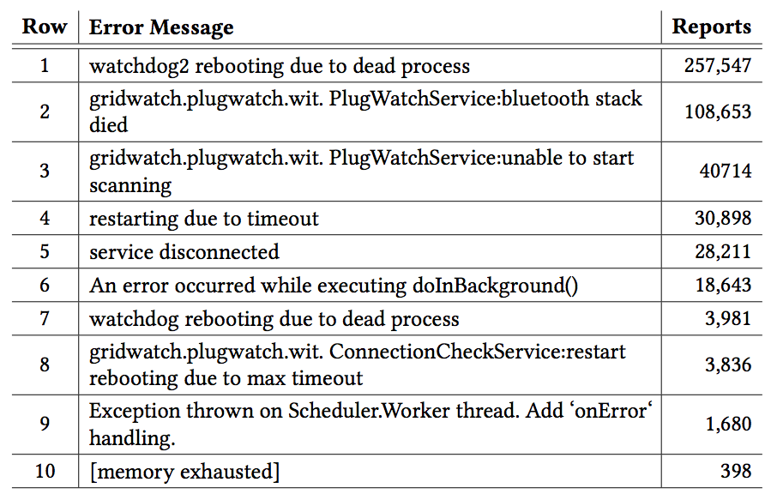
We encountered significant bugs in the Bluetooth Low Energy stack
”stack died”
”failed to scan”
“max timeout”
Notes:
This table shows the top 10 exceptions caught by our app over the course of the deployment. After watchdog failures, the top causes were largely from the Bluetooth stack, coming from [*] unspecified failures from the Bluetooth stack, [*] unexplained errors when Bluetooth scanning failed to start, and [*] unhandled timeouts. The highlighted rows are exceptions directly caused by the BLE stack crashing in Android. These exceptions were a significant source of bugs in our application.

Slide 29
Android’s design makes recovery from subsystem bugs a high-cost operation
When the bug is in the OS, applications don’t have a great recovery strategy
Other computing platforms can power cycle peripherals
Android cannot reboot just the BLE stack
  Had to restart app
  Had to reboot phone
  And the app doesn’t always come back…
Notes:
Unfortunately, when the bug is coming from the OS, an app doesn’t have a great strategy for recovering. We found that unlike traditional embedded systems which can be designed to power cycle peripherals, the Android API does not support this. From a tight association context, this makes a lot of sense. An app that can power cycle subsystems could destroy the user experience. Unfortunately, for our gateway app, in the face of BLE stack errors, basically all we could do was either restart our app, or reboot the phone, both options reducing uptime. More critically, this approach challenged our overall reliability. We found over the course of our deployment that rarely and non-deterministically, when we restarted our app the app wouldn’t start again, or when we rebooted the phone, our app wouldn’t start on boot. In a tight association context, a user can quickly remedy this non-determinism by tapping on an app to reopen it. In loose association, it was fatal for system and would take that phone offline until a human visited.

Slide 30
Hypothesis / Outline
Smartphones enable unattended long-running networked sensing applications through their rich supporting environments, wireless peripheral connectivity, and physical reliability.
Notes:
Ok. Nearly there.

Slide 31
Hypothesis / Outline
Smartphones enable unattended long-running networked sensing applications through their rich supporting environments, wireless peripheral connectivity, and physical reliability.
Notes:
Surely the phones were physically reliable right? Has anyone really ever had a problem with the phone in their pocket?

Slide 32
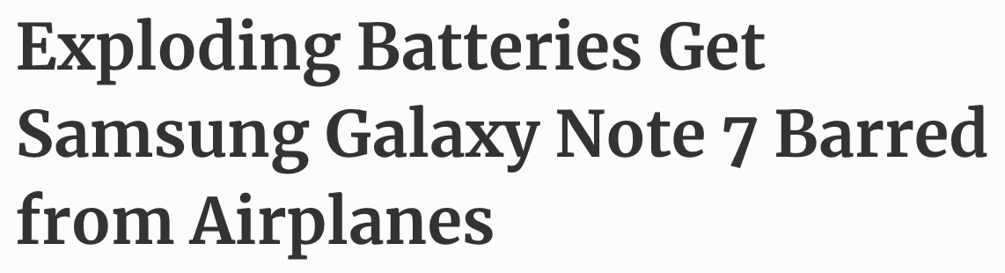
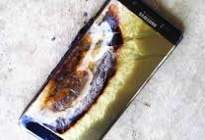
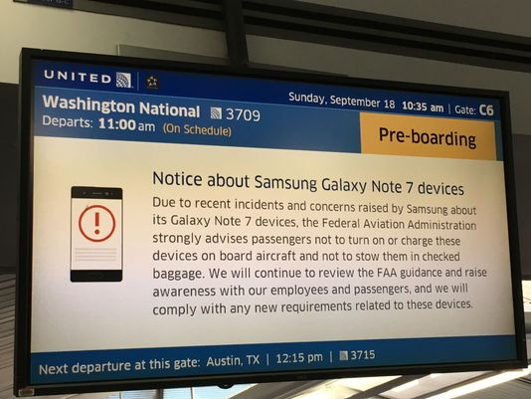
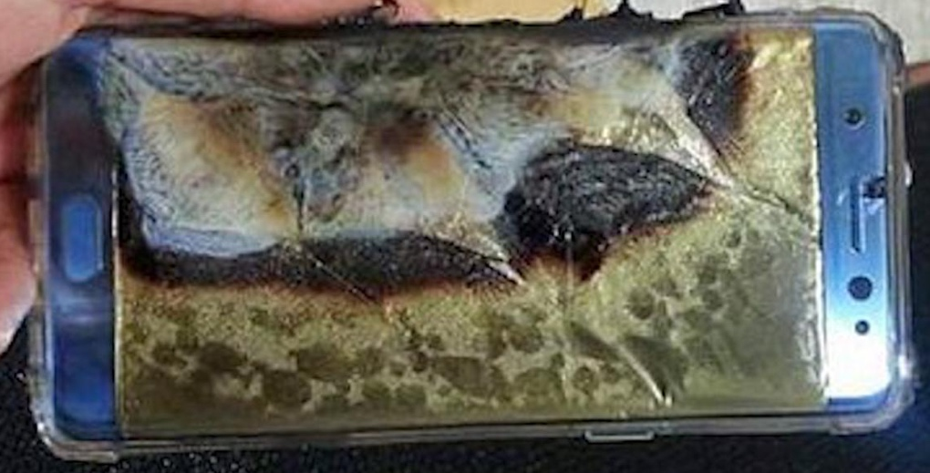
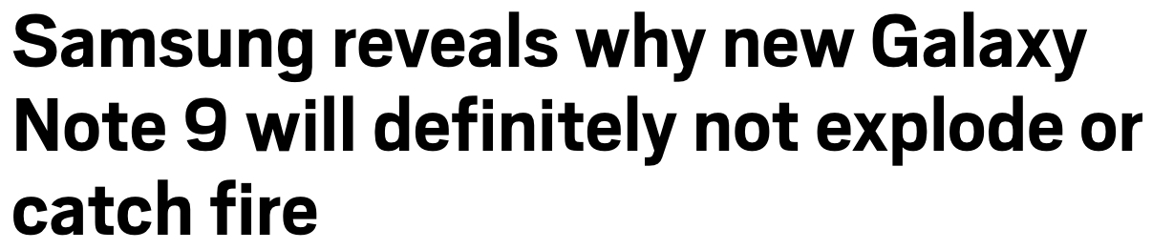
Hypothesis / Outline
Smartphones enable unattended long-running networked sensing applications through their rich supporting environments, wireless peripheral connectivity, and physical reliability.
Notes:
Turns out we were just a few months ahead of the curve on this one, and physical reliability was one more bad assumption.

Slide 33
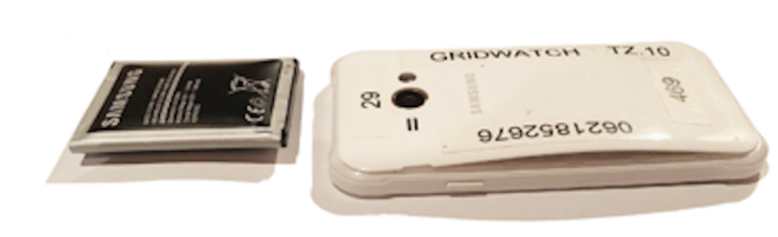
Batteries failed catastrophically
Not much data available on the effects of unsupervised long-running applications on batteries
We baked phone running app in an oven at 120°F for 18 hours, did not reveal issues
Notes:
When we collected the phones we were completely horrified to see that the batteries had catastrophically failed on 8 of the 16 phones. The worst of these failures was a battery that was 270% thicker than when started. Before deploying, we had done some thermo due diligence. We put our phone in an oven for 18 hours at 120 degrees Fahrenheit, around 49 Celsius, for 18 hours and logged the changes in charge rate and whether there were any system restarts. We didn’t see anything out of the ordinary. Post-mortem, when we went back to find datasheets on the battery, we couldn’t track one down to even find the tolerance we would need to a future system to meet. Again, it isn’t unreasonable to do more advanced battery testing, but the assumption in our latent hypothesis that we could trust the physical reliability of commercial hardware was shown to be incorrect for our deployment.

Slide 34
Hypothesis / Outline
Smartphones enable unattended long-running networked sensing applications through their rich supporting environments, wireless peripheral connectivity, and physical reliability.
Notes:
Ok.

Slide 35
Hypothesis / Outline
Smartphones enable unattended long-running networked sensing applications through their rich supporting environments, wireless peripheral connectivity, and physical reliability.
Notes:
So this doesn’t look great. But what are we left with.

Slide 36
Hypothesis / Outline
Smartphones enable unattended long-running networked sensing applications through their rich supporting environments, wireless peripheral connectivity, and physical reliability.
Notes:
Smartphones.

Slide 37
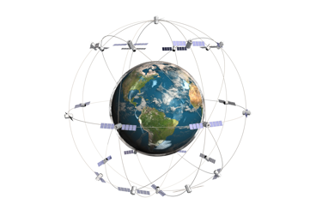

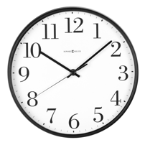
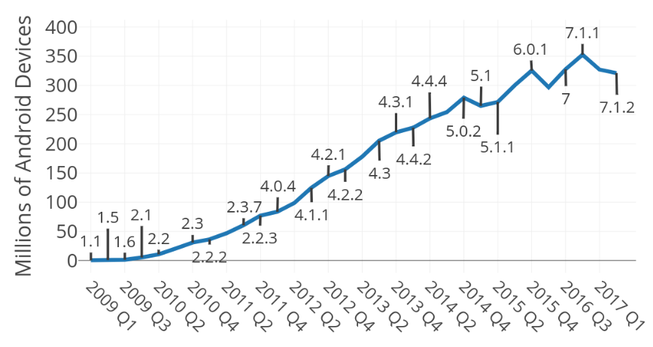
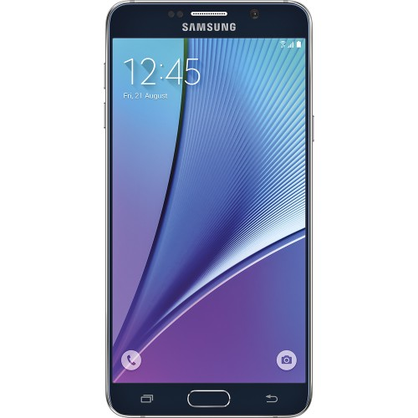
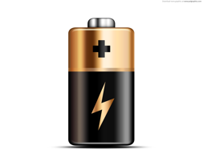
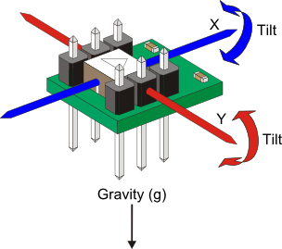
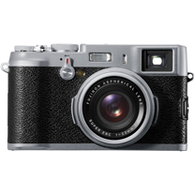

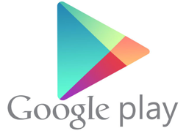

Phone reuse is a huge opportunity to enable compute and reclaim e-waste.
GPS
Notes:
There are billions of devices on the market and some will be discarded with remaining functionality that could be harnessed for sensing or edge applications. [*] Further devices have a ton of internal sensors, potentially allowing them to be reused as not just gateways, but also as standalone sensors. This has been identified multiple times as a huge opportunity, but many of the killer apps are loose association.

Slide 38
Loose association requires future work
Android is doubling down on tight association (as they should)
A loose association version of Android
A solution for heterogeneity
Recycling centers
https://developer.android.com/distribute/best-practices/develop/runtime-permissions
Notes:
Unfortunately, our experience suggests that we won’t just be able to to trivially re-use phones. Newer versions of Android have introduced privacy protections and system resource protections that are great for the user experience but would likely present additional hurdles for loose association applications like ours. Loose association may require an entirely separate branch of Android. To cover the whole population, this hypothetical branch should support versions of hardware that are no longer supported by the newest versions of Android. Finally, we imagine infrastructure like a trained population or recycling center that would be willing to interact with the phones to convert them to their new loose association context.

Slide 39
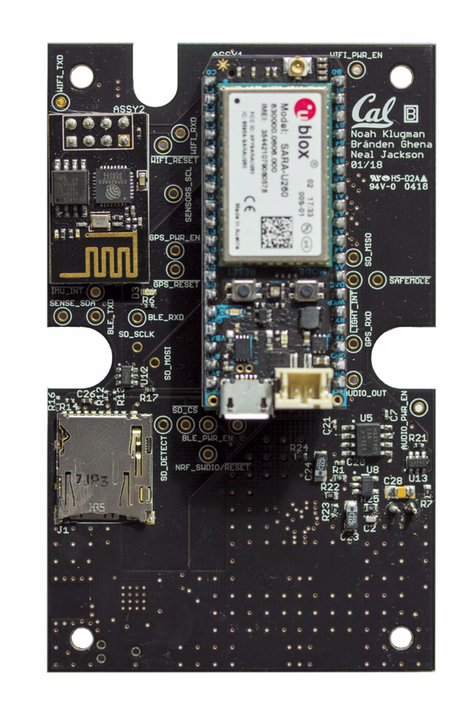
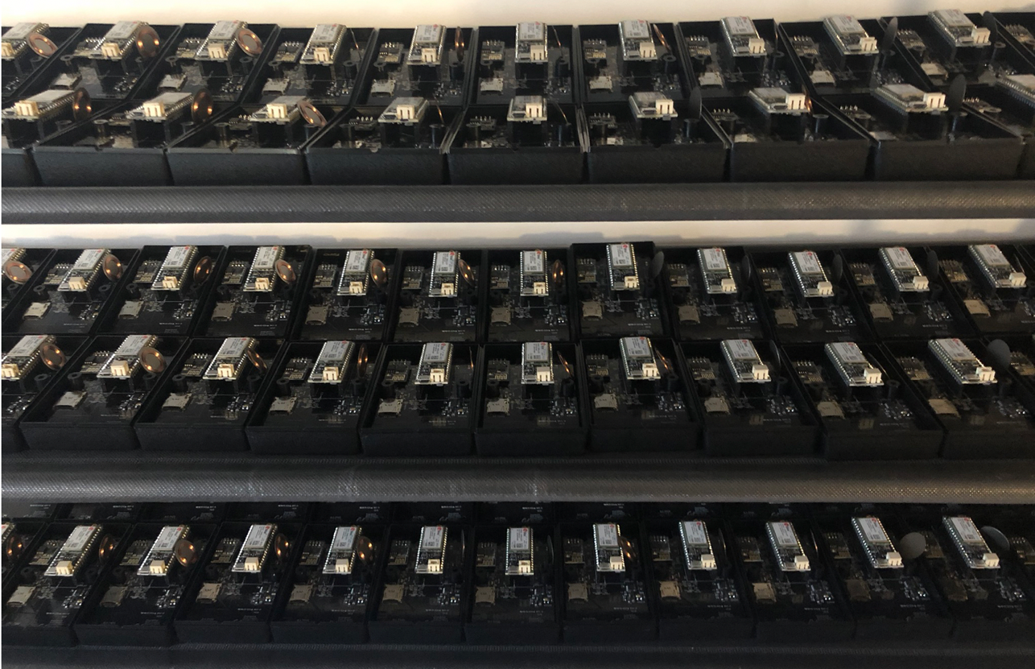
The PlugWatch is dead. Long live the PowerWatch.
Custom hardware solution developed and deployed in Ghana
Hundreds of sensors and millions of data points
PowerWatch: Noah Klugman, Josh Adkins, Pat Pannuto, Matt Podolsky, Neal Jackson, Branden Ghena, Jay Taneja, Prabal Dutta
PowerWatch devices being prepared for deployment
Notes:
To wrap up, our team has since moved away from Android. We built a similar system to PlugWatch called PowerWatch which is a custom embedded system. It took less time to develop and is deployed at a 10x scale of PlugWatch with high reliability.

Slide 40
Thank you!
Experience: Android Resists Liberation from Its Primary Use Case
Noah Klugman†, Veronica Jacome†, Meghan Clark†, Matthew Podolsky†,Pat Pannuto†, Neal Jackson†, Aley Soud Nassor‡, Catherine Wolfram†, Duncan Callaway†, Jay Taneja*, and Prabal Dutta†
†
*
‡
University of California, Berkeley
Department of Electrical Engineering
Department of Energy and Resources
Energy Institute at the Haas Business School
University of Massachusetts, Amherst
Department of Electrical Engineering
The State University of Zanzibar
Department of Development Studies
Notes:
Thank you so much for listening. I’ll be happy to take any questions.

Slide 41
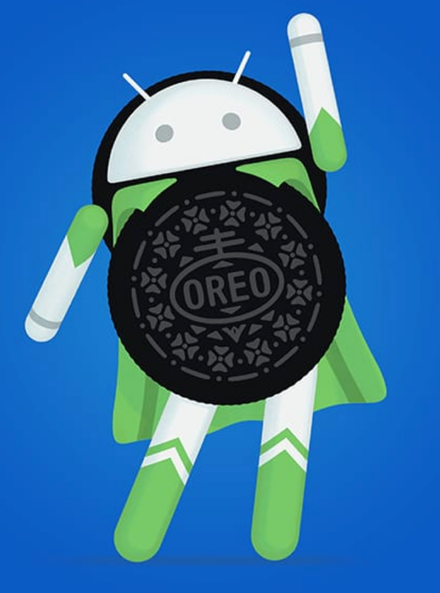
However, this problem will get worse in the future
Android is moving further towards tight association (for good reasons)
https://developer.android.com/distribute/best-practices/develop/runtime-permissions
https://www.android.com/versions/oreo-8-0/

Slide 42
Hypothesis / Outline
Smartphones enable long-running networked sensing applications through their rich programming environments, wireless peripheral connectivity, and broad reliability.

Slide 43
What our experience doesn’t claim
A statement that a PlugWatch style architecture would never work
  There are better Android programmers
  There are newer versions of Android
  There are helpful third party software tools
A call to move away from Android based sensing
  This would be a disaster
A full understanding of exactly why Android failed

Slide 44
What our experience does claim
Long running Android sensors are not supported out of the box
Built-in logging didn’t support a great post-mortem
Deployment management is hard
It was easier to spin our own system

Slide 45
Design Decision: Android in a Box
Hypothesis: Android phones let us use on phone sensors (user first permissions), off board sensors (bugs), are readily available (sims), have a high level programming environment (ota updates / logging / rooting), are inexpensive (moved to Samsung phones), are reliable (batteries got big, can’t do specific subsystem restarts)
Hypothesis: Smartphones provide a rich programming environment, offer integrated sensors, connect wirelessly with nearby peripherals, are available at scale, and offer high reliability.
Hypothesis: Smartphones enable networked sensing applications through their rich programming environments, integrated sensors, wireless peripheral connectivity, and broad availability.
How many of you have turned off your phone already today? How many people haven’t rebooted their phone in a day… how many typically reboot their phone every day… every week… every month… can you remember it? And also everyone in the room has a phone
Strike off points until just left with smartphones…
Quick review of GridWatch

Slide 46
Giving away the end
This work reports a negative experience.
We structure this talk around how this experience disproves our hypothesis.

Slide 47
Outline
Hypothesis: Android phones let us use on phone sensors (user first permissions), off board sensors (bugs), are readily available (sims), have a high level programming environment (ota updates / logging / rooting), are inexpensive (moved to Samsung phones), are reliable (batteries got big, can’t do specific subsystem restarts)

Slide 48
Hypothesis / Outline
Smartphones enable long-running networked sensing applications through their integrated sensors, rich programming environments, wireless peripheral connectivity, and broad reliability.

Slide 49
Evidence Supporting
Smartphones enable long-running
networked sensing applications
through their integrated sensors,
rich programming environments,
wireless peripheral connectivity,
and broad reliability.
Number of sensors per phone
Huge amount of academic work using mobile phones as sensors
Easy to use OS manager

Slide 50
The user comes first
Smartphones enable long-running
networked sensing applications
through their integrated sensors,
rich programming environments,
wireless peripheral connectivity,
and broad reliability.
Permissions need to be handled
  Limited OTA updates
Other boxes need to be handled
  Accessibility services
https://developer.android.com/distribute/best-practices/develop/runtime-permissions

Slide 51
Hypothesis / Outline
Smartphones enable long-running networked sensing applications through their integrated sensors, rich programming environments, wireless peripheral connectivity, and broad reliability.

